Slide 1
Image Classification using Machine Learning and Deep Learning
By:
Pravek Sharma

Slide 2
Images are the most basic and elementary source of learning for any level of education. Being such an incredible and interesting way of exhibiting information and providing the most efficient way of grasping that knowledge, we would just love to have the information about what the image is when we look at it, here whether the image is of an animal, building or any landscape. We see images everywhere in our day-to-day life. A child is taught how to differentiate between objects and living beings with the help of images. It would be so comforting and easy if all we would need is a picture for us to learn what is the image about!
It is amazingly INTERESTING!!!

Slide 3
The Problem Statement:
To “classify” animal, building and landscape images from the dataset when as an input
To classify is to be able to identify the parts and differences.
Deep Learning model and algorithm can be implemented in order to
classify accordingly.
To make a user friendly and viewing easier, just the image path should be required.

Slide 4
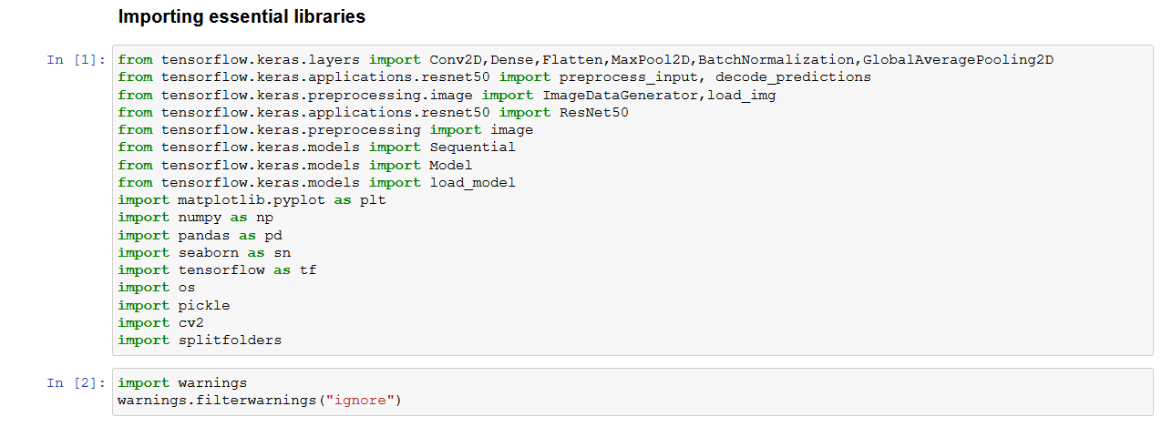
TOOLS USED
MatplotLib: It is a plotting library that can be used for analyzing the data after plotting different graphs.
Numpy: Used for working with arrays, functions for working in domain of linear algebra, Fourier transform, and matrices.
Pandas: We can perform a lot of operations with group by, data frames, series, missing data, cleansing of data, analyzing of data, etc.
Seaborn: This library can be used to make to the graph look better and understandable. It has many inbuilt plotting methods like line plot, box plot, bar plot, etc.

Slide 5
TOOLS USED
Tensorflow: Used for training and inference of deep neural networks. A symbolic math library based on dataflow and differentiable programming.
OS: It provides functions for creating and removing a directory, fetching its contents, changing, and identifying the current directory.
Pickle: It's the process of converting a python object into a byte stream to store it in a file/database, maintain program state across sessions, or transport data over the network.

Slide 6
TOOL USED
Splitfolders: Split folders with files (e.g., images) into train, validation, and test (dataset) folders.
Warnings: Warnings are provided to warn the developer of situations that aren't necessarily exceptions. A warning in a program is distinct from an error. Setting it as “ignore”, ignores unnecessary and blunt warnings.

Slide 7
OBJECTIVE
The major objective of undertaking this project is to classify 3 sets of classes, namely, animals, buildings, and landscapes. The model after completion of training should ultimately be able to tell us whether the input path of the image is of an animal, a building, or a landscape.

Slide 8
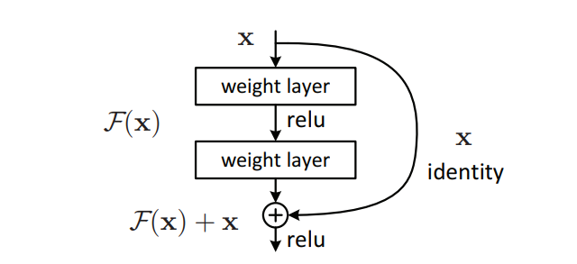
METHODOLOGY
Residual Neural Network:
After the first CNN-based architecture AlexNet, which works for a smaller number of layers. But when we increase the number of layers, there is a common problem in deep learning associated with that called Vanishing/Exploding gradient. When we increased number of layers, the training and test error rate also increases. ResNet, introduced a new architecture called Residual Network to solve the problem of the vanishing/exploding gradient. In this network we use a technique called skip connections. The skip connection skips training from a few layers and connects directly to the output.

Slide 9
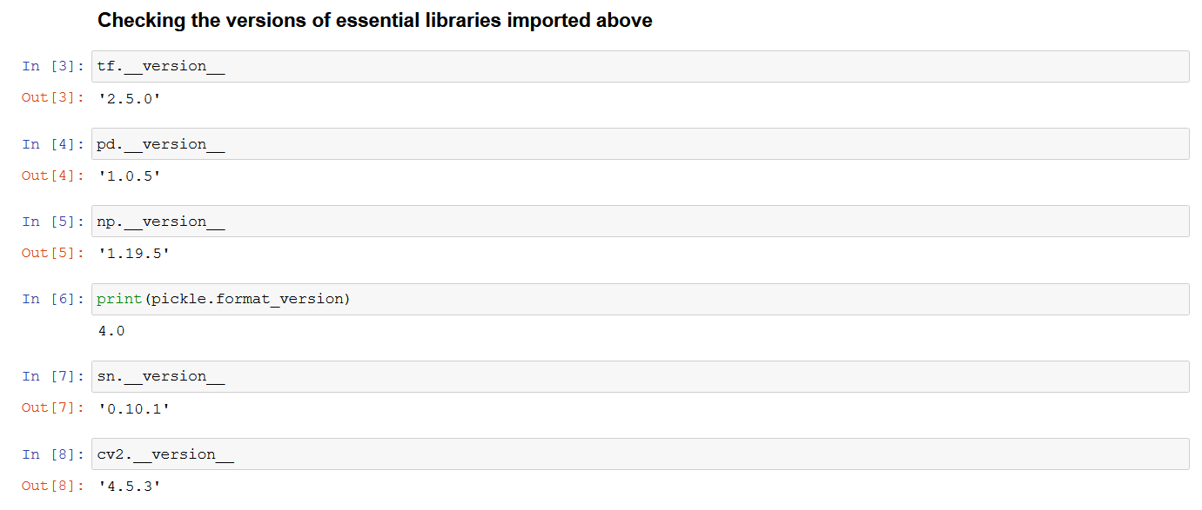
IMPLEMENTATION
Step 01:
The basic and initial steps are the importing of libraries that are used throughout the model.
To keep the model up to date in every possible way, the versions of the key important libraries were rechecked.

Slide 10
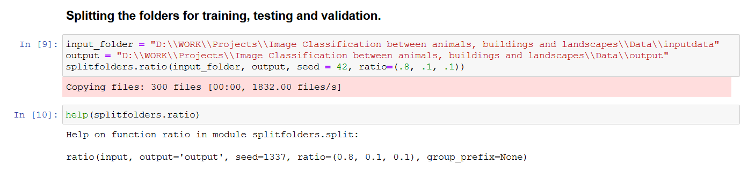
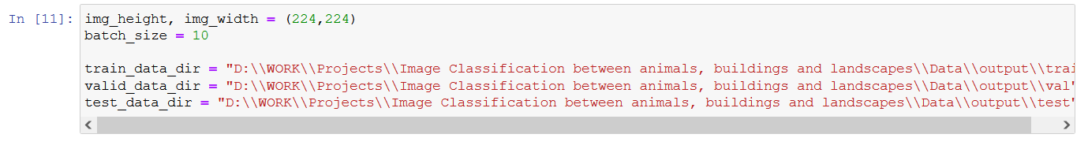
Step 02:
We now split our dataset into training, testing, and validation folders, respectively. After importing the splitfolders library, we need to provide the input and output path. The seed is for the random sampling of the images. We provide the ratio as per which the images will be distributed in training (80%), testing (10%), and validation (10%). We provide the path to the training, testing, and validation dataset directory, so that the images can separately be excessed.

Slide 11
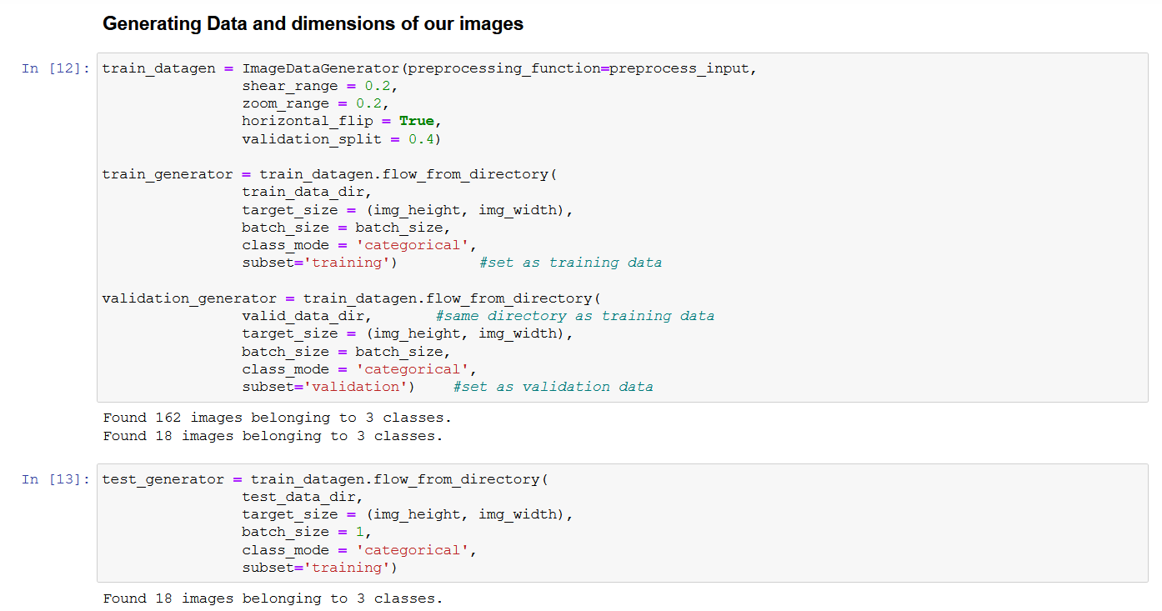
Step 03:
Utilizing the ImageDataGenerator, with multiple augmentations of the images like sheer range, zoom range, horizontal flip, validation split. The batch size for the test generator is taken as 1, whereas the same can be taken for higher values in validation and train generators. The class mode that is set to categorical in the three generators is categorical because the type of label arrays that will be returned would be 2-D one hot encoded labels (for mutually exclusive labels).

Slide 12
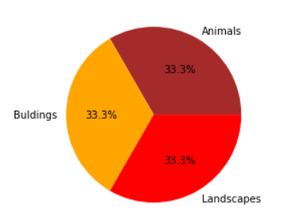
The Dataset that has been taken is a random selection of images for the classes namely, animals, buildings and landscapes from google images. Each class in its own directory consists of a 100 images.

Slide 13
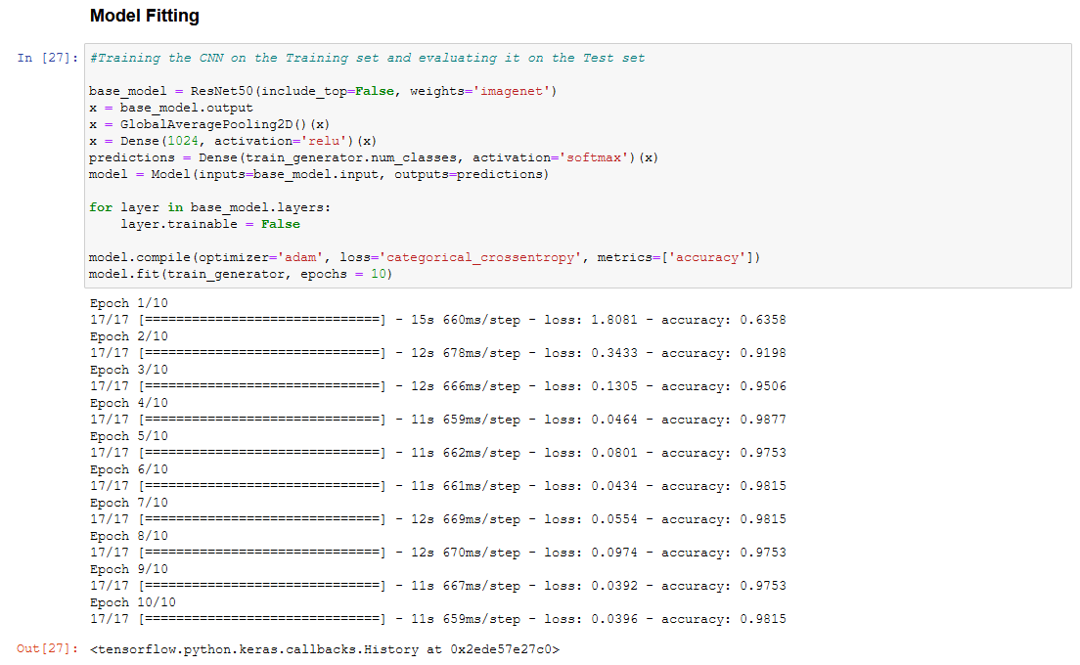
Step 04:
Base model as ResNet50, we provide the include top as false because ResNet50 is trained for 1000 classes of imagenet dataset (transfer learning), but we only want to predict for the three classes. We put our own dense layer as output for the ResNet50. Our base model output layer with another dense layer with activation set to relu will be stored as x. Our prediction will be one additional dense layer in front of the x defined with activation function set to softmax. We define a model which takes the input from the base model and output is the final most layer. Keeping model as trainable the model will be less time effective. Therefore, we keep false for the trainable layer.
Now compiling the model for multiple epochs which will ultimately provide us with the total loss and accuracy of the model.

Slide 14
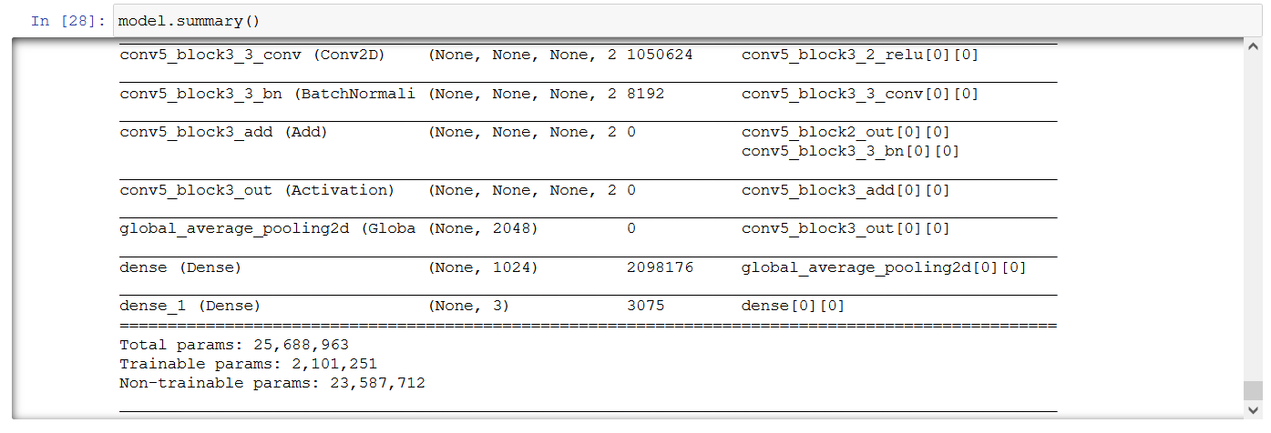
Difference between ReLu and Softmax Activation Functions The difference between relu and softmax is that a rectified linear unit has output 0 if the input is less than 0. That is, if the input is greater than 0, the output is equal to the input. ReLUs' machinery is more like a real neuron in your body. The softmax function squashes the outputs to be between 0 and 1. It also divides each output such that the total sum of the outputs is equal to 1. The output of the softmax function is equivalent to a categorical probability distribution, it tells you the probability that any of the classes are true.
As we are using a transfer learning model, ResNet50, the non trainable params will be significantly more than the trainable params. This is purely because we just have 3/1000 classes to work with.

Slide 15
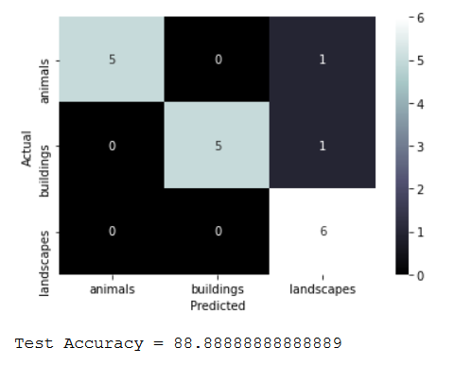
Step 05:
Confusion Matrix: It lets the visualization of the performance of an algorithm.
a. True Positive (TP): when true value is positive but predicted value is positive.
b. False Negative (FN): when true value is positive but predicted value is negative.
c. True Negative (TN): when true value is negative but predicted value is negative.
d. False Positive (FP): when true value is negative but predicted value is positive.

Slide 16
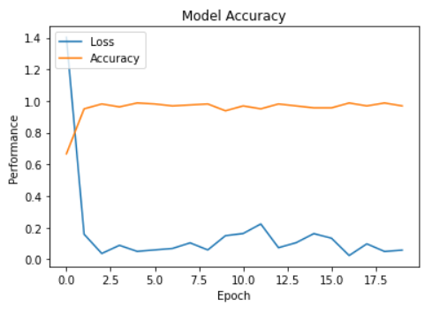
The plot shows the loss and accuracy of the model. The graphical plot is a Model Accuracy plot which simplifies the performance of the model per epoch in terms of loss and accuracy. The loss decreases and the accuracy increases. We notice that the accuracy starts off with an unexpected lower value, but as the epochs increase the accuracy increases and is approximately 1.0. Whereas, studying the graph for the loss, it is seen that the loss is tremendous in the beginning, but as the epochs increase, the loss decreases to less than 0.1.

Slide 17
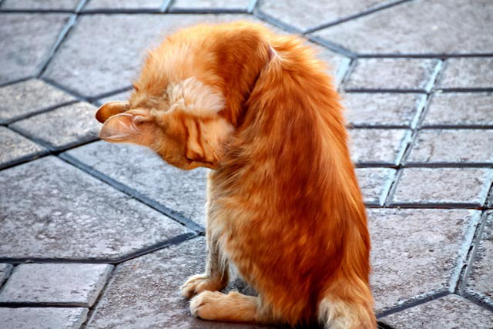
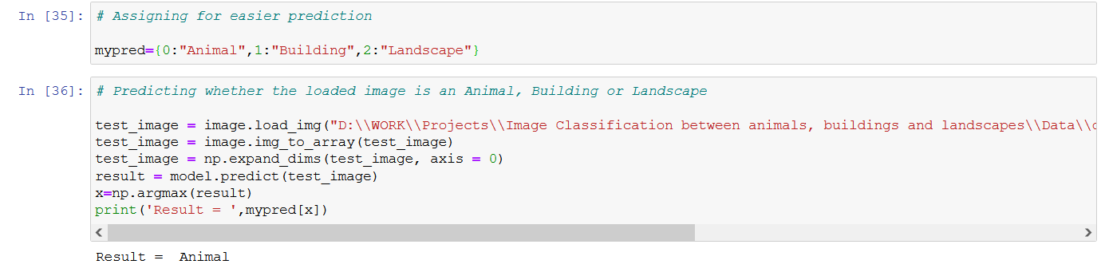
RESULT

Slide 18
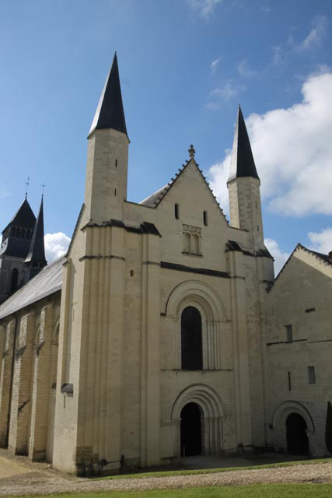

RESULT

Slide 19
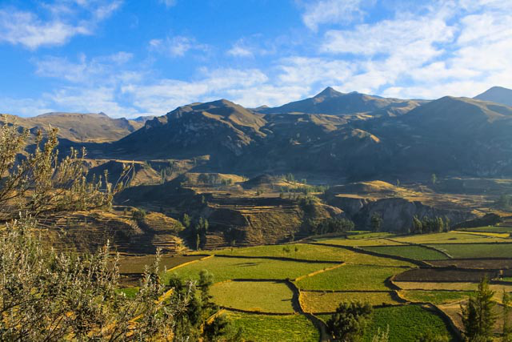

RESULT

Slide 20
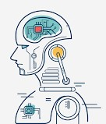
Conclusion
Based on the confusion metrics and test accuracy and furthermore the results of the user input images gives the perfect reason for us to believe that the transfer learning model for image classification is fully functional and is capable of significantly correct predictions in terms of classification of the three classes, i.e., animals, buildings and landscapes.

Slide 21
REFFERENCES
Kaiming He, Xiangyu Zhang, Shaoqing Ren, Jian Sun: "Deep Residual Learning for Image Recognition", (Thu, 10 Dec 2015 19:51:55 UTC)
Rashidedin Jahandideh, Alireza Tavakoli Targhi, Maryam Tahmasbi: "Physical Attribute Prediction Using Deep Residual Neural Networks", (Wed, 19 Dec 2018 10:19:19 UTC)
Fei Wang, Mengqing Jiang, Chen Qian, Shuo Yang, Cheng Li, Honggang Zhang, Xiaogang Wang, Xiaoou Tang: "Residual Attention Network for Image Classification", Proceedings of the IEEE Conference on Computer Vision and Pattern Recognition (CVPR), 2017, pp. 3156-3164
Amin Fadaeddini, Mohammad Eshghi, Babak Majidi: "A Deep Residual Neural Network for Low Altitude Remote Sensing Image Classification", 2018 6th Iranian Joint Congress on Fuzzy and Intelligent Systems (CFIS)
Varun Arvind, Anthony Costa, Marcus Badgeley, Samuel Cho, Eric Oermann: "Wide and deep volumetric residual networks for volumetric image classification", Mon, 18 Sep 2017 04:30:13 UTC
https://economictimes.indiatimes.com/magazines/panache/computer-scientist-russell-kirsch-who-invented-pixel-passes-away-at-91/articleshow/77539556.cms
https://www.thinkautomation.com/eli5/eli5-what-is-image-classification-in-deep-learning/
https://towardsdatascience.com/machine-learning/home
https://www.investopedia.com/terms/d/deep-learning.asp
https://www.geeksforgeeks.org/residual-networks-resnet-deep-learning/
https://www.rfwireless-world.com/Terminology/Advantages-and-Disadvantages-of-Deep-Learning.html
https://www.google.com/imghp?hl=EN
https://machinelearningmastery.com/difference-between-a-batch-and-an-epoch/
https://www.analyticsinsight.net/innovative-industry-implementations-image-recognition- capabilities/
https://github.com/Kulbear/deep-learning-nano-foundation/wiki/ReLU-and-Softmax-Activation-Functions
https://machinelearningmastery.com/confusion-matrix-machine-learning/

Slide 22
THANK YOU

